Slide 1
Global State

Slide 2
Initial Problem Example
Garbage Collector
  Free’s up memory which is no longer in use
  Check’s if a reference to memory still exists
What about in a distributed system

Slide 3
Initial Problem Example (cont’d)
A distributed system consists of multiple processes
Each process is located on a different computer
  No sharing of processor or memory

Slide 4
Initial Problem Example (cont’d)
Each process can only determine its own “state”
Problem: How do we determine when to garbage collect in a distributed system?
  How do we check whether a reference to memory still exists?

Slide 5
System Model
A distributed system consists of multiple processes
Each process is located on a different computer
Each process consists of “events”
An event is either
  sending a message,
  receiving a message,
  or changing the value of some variable
Each process has a communication channel
  in and out

Slide 6
Our Garbage Collection Problem
In order to test whether a certain property of our system is true, we cannot just look at each process individually
A “snapshot” of the entire system must be taken to test whether a certain property of the system is true
This “snapshot” is called a Global State

Slide 7
Definition
The global state of a distributed system is the
set of local states of each individual processes involved in the system
plus
the state of the communication channels

Slide 8
How to record the global state
Distributed snapshot
  reflects a state in which the distributed system might have been
  reflects a consistent global state
  If we have recorded that process P has received a msg from another process Q, then we should also have recorded that process Q had actually sent the msg
  The reverse condition (Q has sent a msg that P has not yet received) is allowed.

Slide 9
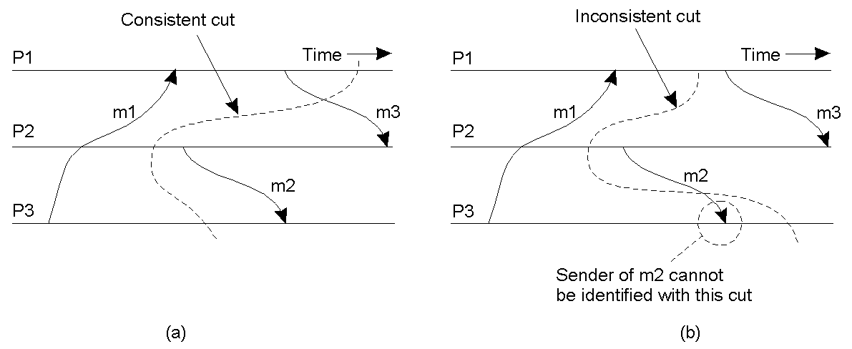
Cut!
A cut represents the last event that has been recorded for each of several processes.
  All recorded msg receipts have a corresponding recorded send event
An inconsistent cut would have a receipt of a msg but no corresponding send event

